Slide 1

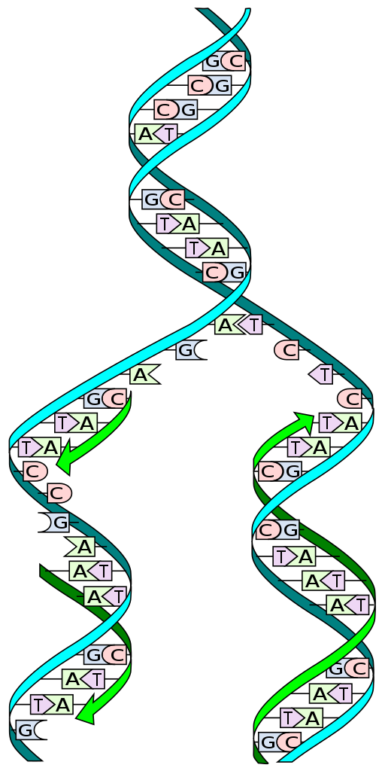
Primer Design & Testing Tool For Mycoplasma Detection
Capstone Project Phase A-24-2-R-12
Supervisor: Dr. Zakharia Frenkel
Qotiba Mhamed
Abdallh Amarya

Slide 2

Introduction
The main problem
The main problem is the difficulty in detecting pathogens like Mycoplasma due to strain variability, lack of a cell wall, and limitations of traditional methods.
Our proposed solution
The proposed solution involves using advanced algorithms to design primers targeting conserved DNA regions, improving the sensitivity and specificity of PCR-based assays.

Slide 3

Research Significance
Improved Mycoplasma Detection.
Focus On Conserved Regions
Advancement In Molecular Diagnostics
Clinical And Research Impact

Slide 4
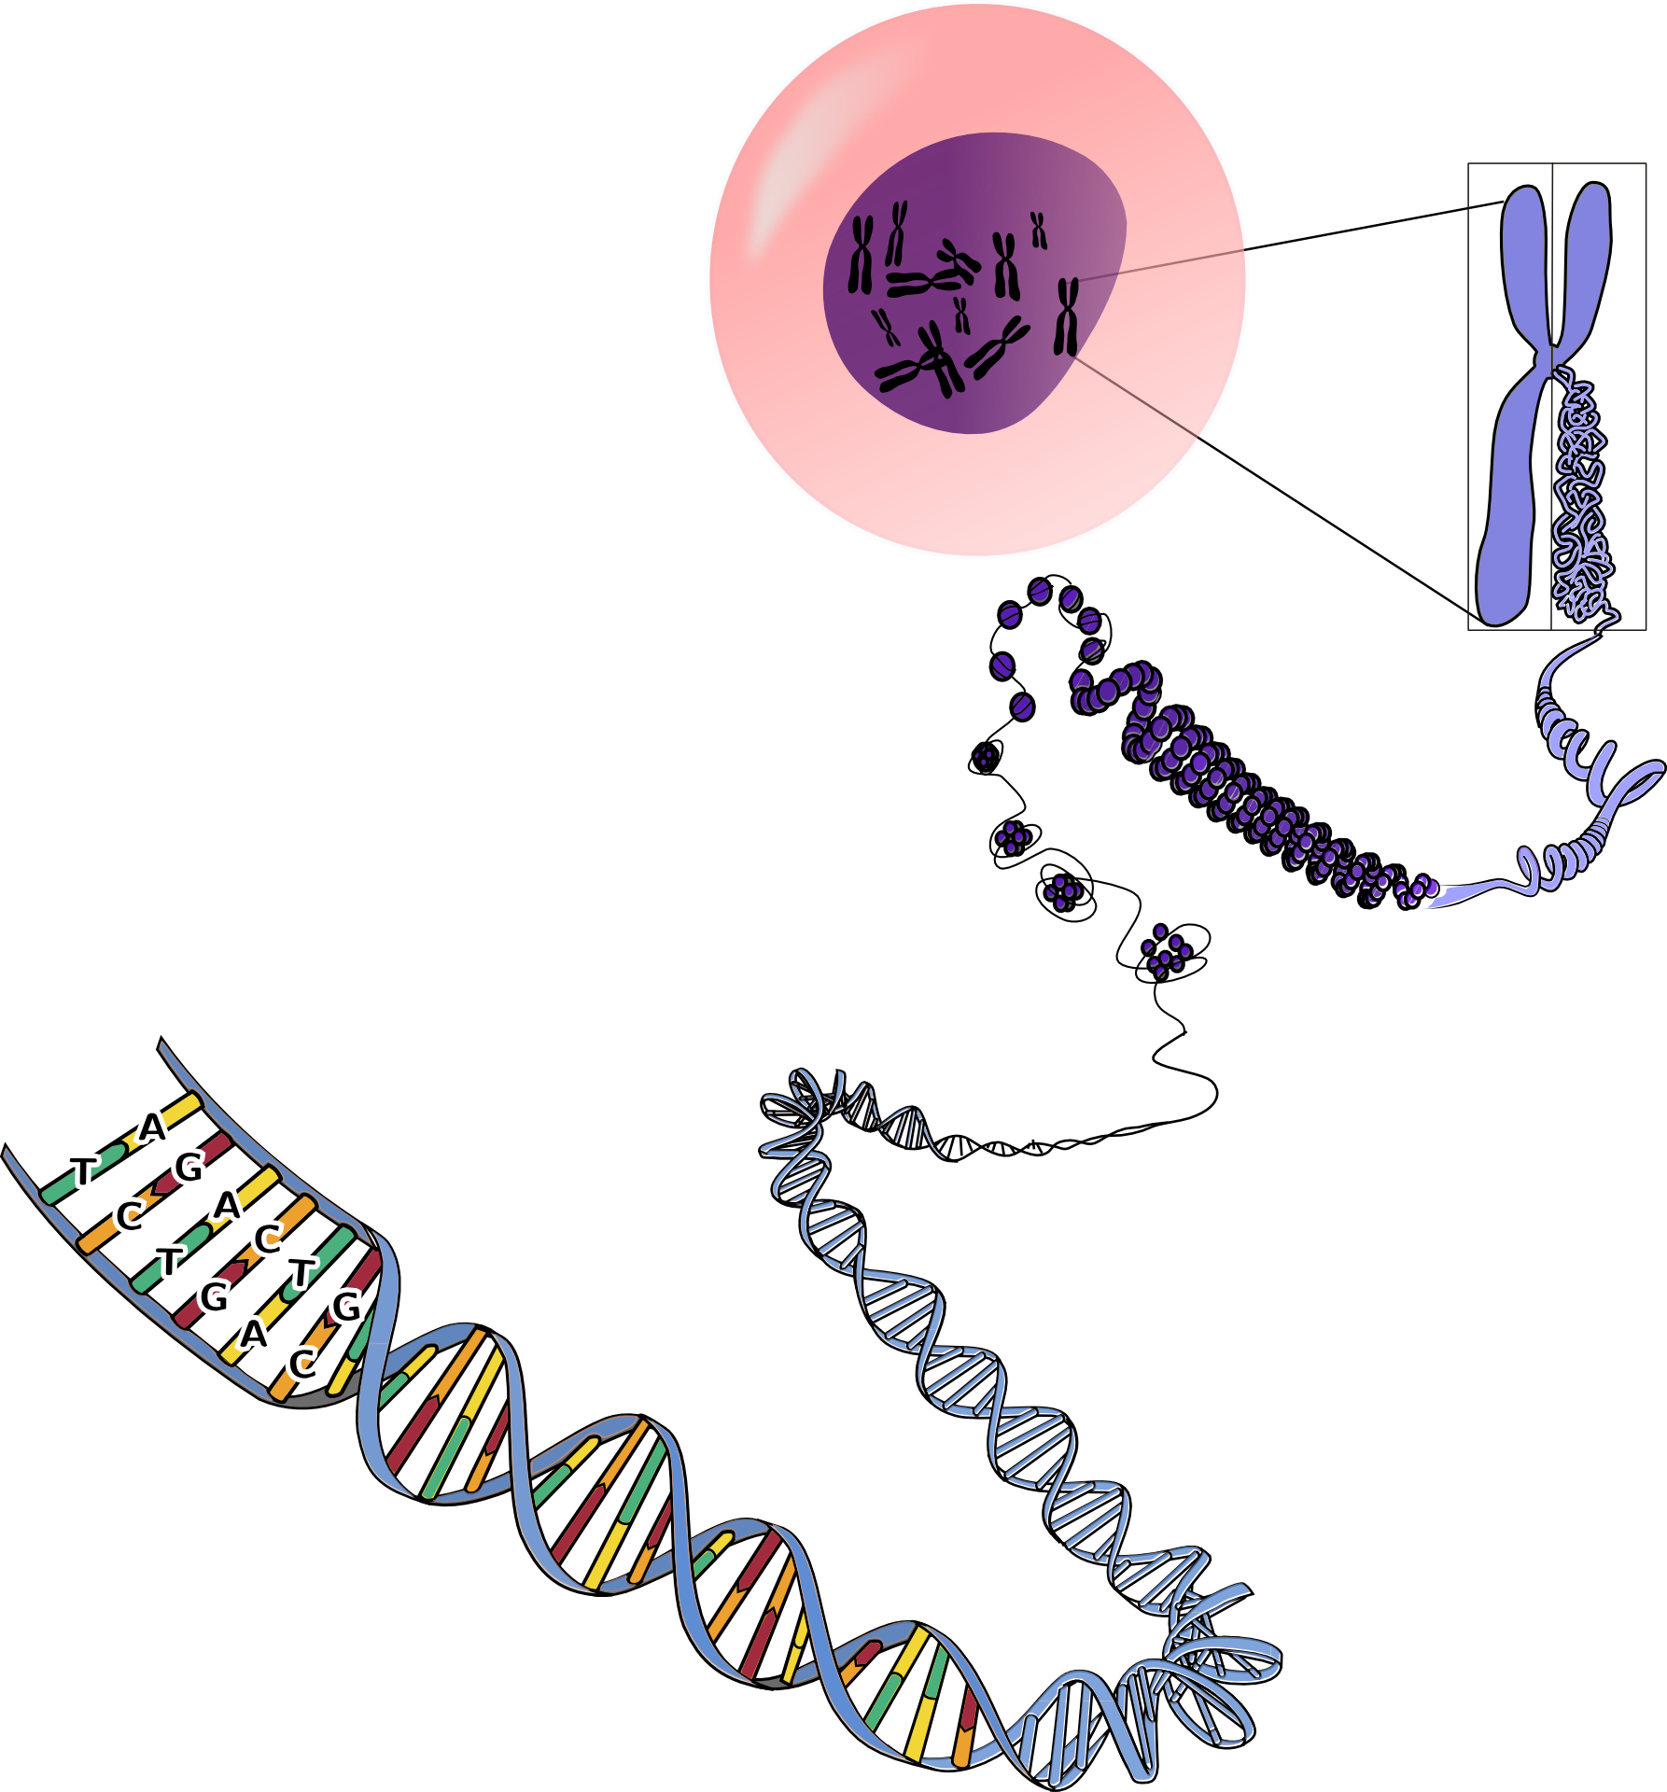
Biological overview
01
02
DNA
Primers
03
PCR
Notes:
DNA is the molecule that carries genetic information for the development and functioning of an organism
DNA is made of two linked oppositely directed strands that wind around each other to resemble a twisted ladder (double helix)
Each strand is composed of subunits of four types: adenine (A), cytosine (C), guanine (G) or thymine (T)
The two strands are connected by bonds between the bases: A bonds with T, and C bonds with G

Slide 5
The Problem of Finding Conserved Regions in DNA
Genetic Variability.
Low Abundance of Target DNA.
Non-Specific Amplification.
Algorithmic Comlexity.

Slide 6
The patterns of conserved regions identified
Invariant Regions: Unchanged DNA sequences across Mycoplasma strains, allowing for broad detection.
Unique Stable K-mers: Fixed-length K-mers are analyzed, focusing on unique and consistent sequences.
High Sequence Identity Threshold: A 99% threshold ensures specificity to Mycoplasma, avoiding similarities with related species or host genomes.
Optimal Primer Regions: Primers are designed for stable melting temperatures and GC content, ensuring effective PCR and qPCR amplification.

Slide 7
Algorithms
01
Divide a given genome DNA into a set of k-mers
02
Delete all “non-specific” k-mers
03
Calculate “primer properties” of the k-mers
04
Compose primers pairs according to the rule

Slide 8
Algorithms
05
Select primers pairs, containing the third primer in the middle region
06
Homology criterion of k-mer X
Select the triple of primers (the pair with the additional third primer) with the minimal sum of the homology criteria of each primer
07
08
Check that all selected primers are present in all variants of the human coronavirus genome

Slide 9

Expected achievements !
Our goal is to develop a robust algorithm for detecting conserved regions in Mycoplasma DNA.
Algorithm Development
Performance Optimization
Validation and Accuracy
User-Friendly Interface

Slide 10
Flow Chart
no
Connected?
Start
Connect to
server
yes
Select DNA
Sequence
Finish
Select
bioinformatics parameters
show
Results
Analyze
Results
Run
System

Slide 11
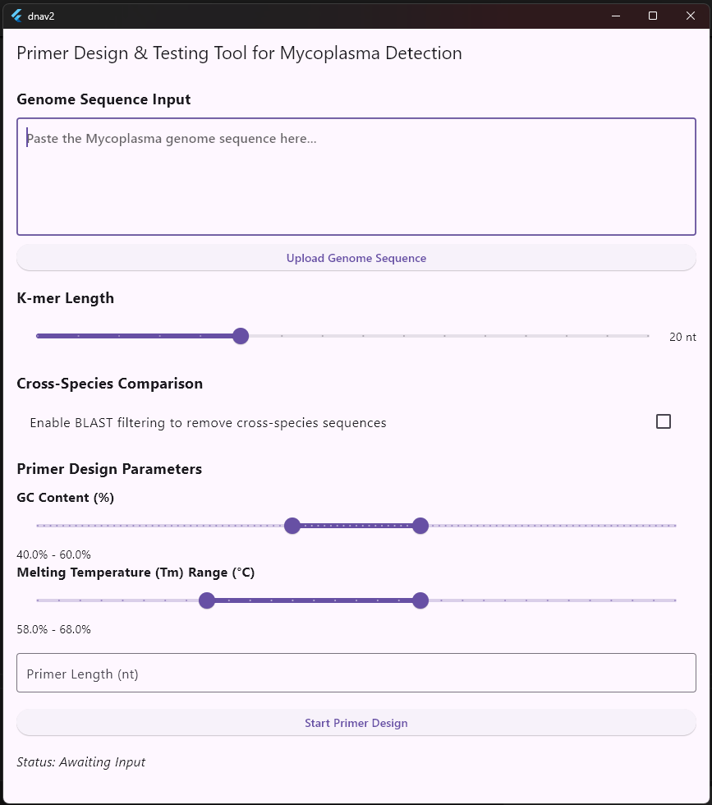

Slide 12
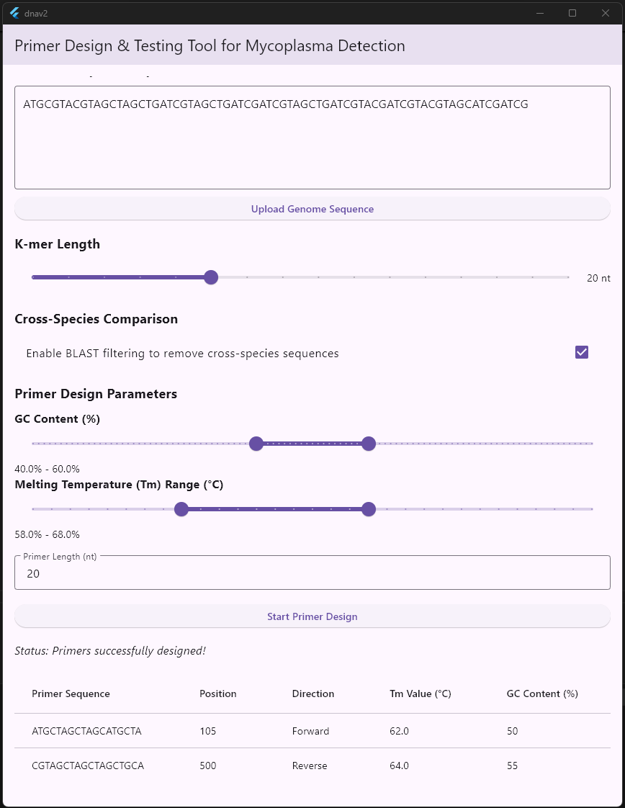
Run system

Slide 13
Research verification plan
Case | Test Case | Expected Result
1 | Run algorithm on a test DNA sequence dataset | The algorithm correctly identifies conserved regions within the Mycoplasma genome.
2 | Analyze K-mer filtering process | The algorithm accurately removes duplicates and cross-species similarities.
3 | Test primer design module | Primers are designed according to specified criteria (GC content, Tm compatibility, etc.).
4 | Validate primer specificity using simulated data | Designed primers show high specificity and minimal non-specific amplification.
5 | Run algorithm with incomplete or erroneous data | The system provides clear error messages and handles incomplete data gracefully.
6 | Assess algorithm’s performance on large-scale datasets | The algorithm efficiently processes large datasets within a reasonable time frame.

Slide 14
Thank You!
Do you have any questions?
msalm46@gmail.com
abosalehmohamed800@gmai.com

